Slide 1

Monte Carlo simulations in wireless communication
BER estimation and SNR envelope
Giacomo Calabria – 12th April 2024
Universitat Politècnica de Catalunya - Stochastic Methods for Optimization and Simulation
Notes:
In this presentation, I’ll focus on wireless communication systems and explore a powerful tool for analysing their performance: Monte Carlo simulations.
First, we introduce a bit the context of the wireless channel and then we provide the model simulated and the results of the simulations.

Slide 2
Introduction
Why we need Monte Carlo simulation?

Slide 3
Signal in Wireless Channels
Wireless communications systems facilitate the transmission of information through radio waves. These radio waves travel through various channels, including air, buildings, and foliage.
Channel impairments like fading, noise, and interference can significantly degrade the transmitted signal.
Fading: Signal strength fluctuates due to multipath propagation and environmental factors.
Noise: Unwanted electrical signals introduced during transmission, corrupting the data.
Interference: Overlapping radio signals from other sources disrupt the desired signal.
Notes:
Wireless communication systems plays a crucial role in our world, enable mobile phones, internet access, and various other applications. However, the journey of a wireless signal from transmitter to receiver is fraught with challenges.
The Wireless channel, the medium through which these signals travel, introduce various impairments. Fading weakens the signal strength, noise adds unwanted distortions, and interference creates confusion with overlapping signals. These impairments can lead to errors in the received data, hindering the system's performance.

Slide 4
Monte Carlo simulation
Traditional analytical methods for analysing communication systems can be unmanageable or even intractable in complex scenarios.
Monte Carlo simulations offer a powerful and versatile approach to overcome these limitations. They rely on repeated random sampling to statistically evaluate system performance under various channel conditions.
Advantages:
Handles complex channel models like Rayleigh fading and Rician fading.
Accounts for non-linearities and system imperfections.
Provides valuable insights into system behaviour for diverse scenarios.
Notes:
Analysing the performance of wireless communication systems with traditional analytical methods can become increasingly complex as channel models become more intricate. For instance, modeling real-world fading phenomena like Rayleigh fading or Rician fading can be mathematically challenging. Additionally, these methods might not account for non-linearities and imperfections present in real systems.
Monte Carlo simulations come to the rescue! They leverage the power of random sampling to statistically approximate system behaviour. By repeatedly simulating signal transmission under different channel conditions, we can gain valuable insights into the system's performance across a wide range of scenarios.

Slide 5
The wireless channel
Statistical model of the wireless channel

Slide 6
Wireless AWGN Channels
We will assume an Additive White Gaussian Noise (AWGN) channel, in this environment the error events arising from channel noise are independent and its described by a Gaussian distribution.
Using Monte Carlo simulation to estimate a performance parameter of a communications system, such as Bit Error Rate (BER), if an estimator is unbiased, we know that, on the average, Monte Carlo simulation provides the correct result.
We use Monte Carlo simulation in communication system with these assumptions:
The channel is assumed AWGN, noise is the only source of error.
Data symbols at the source are independent and equally probable.
No intersymbol interference.
Notes:
For our simulations, we’ll assume an Additive White Gaussian Noise (AWGN) channel, which is a common starting point as the noise is independent across different bits and it follows a Gaussian distribution, which is mathematically convenient and often used to model random noises in various contexts.
We perform Monte Carlo simulations for estimating performance parameters in communication system, such as the Bit Error Rate (BER) and by performing these simulations many times, we can statistically approximate that value of the system. Our estimation is supposed to be unbiased so, on average, the estimated BER will converge towards the actual BER.
In the simulation we will exclude the complexity of InterSymbol Interference (ISI) so each symbol doesn’t overlap with any previous transmitted symbol.

Slide 7

Evaluate the Channel: SNR
The Signal-to-Noise Ratio (SNR) at the receiver is usually a major factor in determining the performance of the system. It is defined as the ratio of the power of a signal to the power of background noise.
In order to compare the BER performance we use a normalized SNR, also known as the «SNR per bit», which is defined as:
$$SNR=\frac{E_{b}}{N_{0}}$$
Where $E_{b}$ is the energy associated with each user data bit and $N_{0}$ is the noise spectral density (noise power).
Notes:
In any communication system, the Signal-to-Noise Ratio (SNR) plays a crucial role in determining its performance. It essentially compares the strength of the desired signal to the level of unwanted background noise. A higher SNR indicates a clearer signal with less noise, leading to better system performance.
For a fair comparison of Bit Error Rate (BER) across different communication systems, we often use a normalized SNR, also known as SNR per bit.

Slide 8


Evaluate the Channel: BER
The parameter we use to analyse our communication system is the Bit Error Rate (BER) which is defined as the ratio of the number of error bits to the total number of bits transmitted during a specific period.
$$BER=\frac{N_{e}}{N}$$
It is the likelihood that a single error bit will occur within received bits, independent of the rate of transmission.
The theoretical relationship between the SNR and the BER for a BPSK scheme is given by:
where $𝒬$ is the Q-function
Notes:
The Bit Error Rate (BER) essentially tells us the probability of errors occurring during data transmission. It's calculated as the ratio of the number of error bits (bits received incorrectly) to the total number of bits transmitted over a specific period.
BER provides a valuable measure of a system's robustness to noise and interference. A lower BER signifies fewer errors and more reliable communication. It's important to note that BER is independent of the transmission rate.
Theoretically, there’s a connection between SNR and BER, expressed by the Q-function. This relationship helps us understand how improving SNR can lead to a lower BER. As the SNR increases, the Q-function value decreases, resulting in a lower BER and more reliable data transmission.

Slide 9
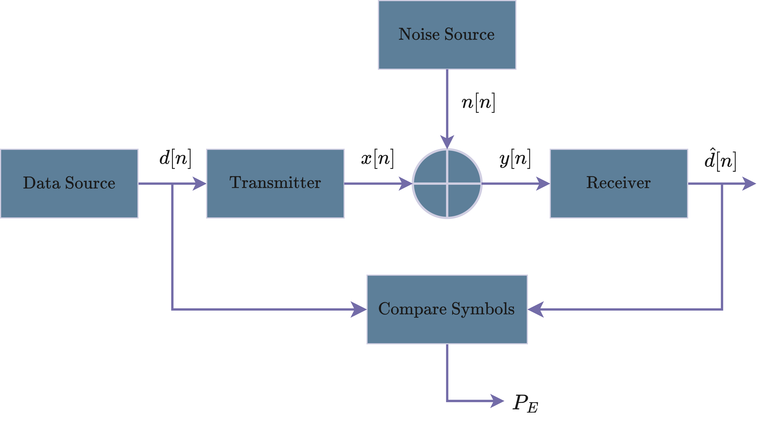
AWGN channel

Slide 10




Simple modulation scheme
Binary Phase Shift Keying, BPSK
Binary Frequency Shift Keying, BFSK
The simplest modulation scheme. The two symbols of the constellation are:
Which delineates two decision regions. The receiver threshold is zero, the case for equally probable signals. The decision rule is:
In this scheme, the two information symbols has direct and quadrature components are defined as:
The signal space is two dimensional, so the decision rule becomes:

Slide 11
Monte Carlo simulation setup

Slide 12
Step in the Monte Carlo simulation
Set up
Random data
Evaluate
Repeat
2 & 3
Analyse results
- Modulation scheme
- SNR steps
- #TX symbols
Generate the random input data to be encoded.
Generate a sample of the AWGN noise with a given σ
Compare IN data with OUT data and check errors.
We count the total number of error to estimate BER.
On each step we vary the SNR, and we store the total number of errors.
Analyse results so on each step of SNR compute the BER.
Plot the graph
SNR vs BER

Slide 13


MC simulation parameter
Vary the SNR form 0 dB to 10 dB with steps of 0.5 dB.
(*)
We perform Nsymbol iteration of the transmission on each SNR step and we account how many times the channel decodes the information wrongly, in order to compute the BER. We choose to simulate with various number of iteration:
$${10}^{3}; {10}^{4}; {10}^{5}; {10}^{6}$$
Then we will compare the resulting BER using both BPSK and BFSK modulation.
(*) Energy and sampling frequancy are normalized.
Notes:
This expression is used to establish the noise standard deviation in the simulations that follow.

Slide 14
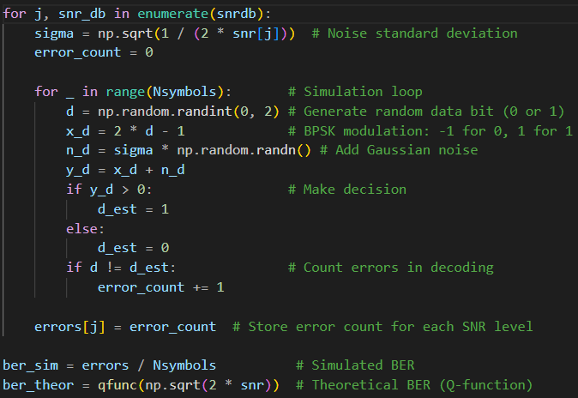
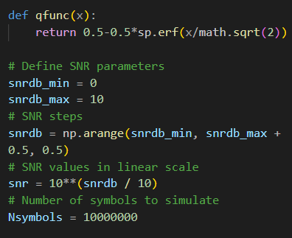
Python code
Here some snaps of the main parts of the code:

Slide 15
BER simulation results
Comparing different modulation schemes and number of iterations

Slide 16
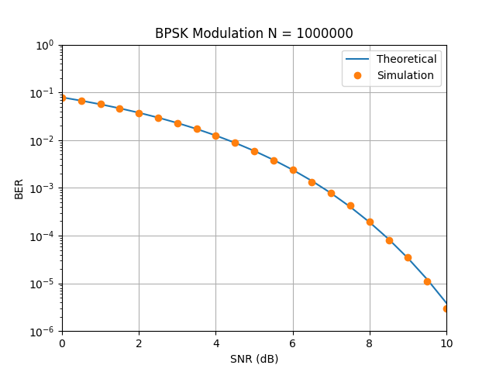

Varying the number of iteration

Slide 17
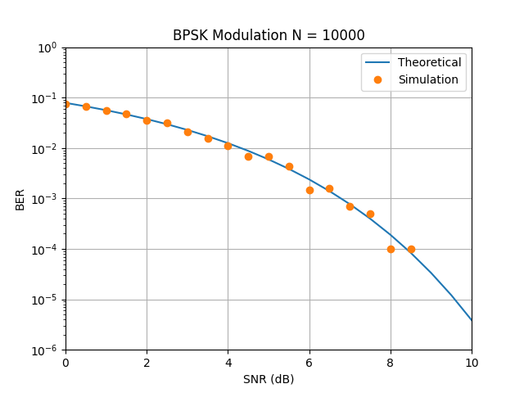
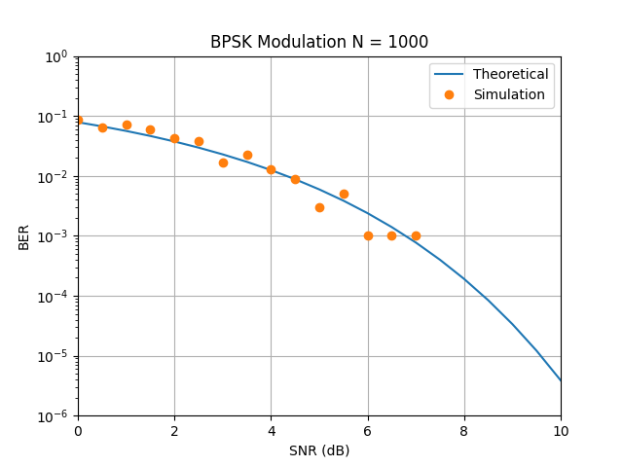
Varying the number of iteration

Slide 18
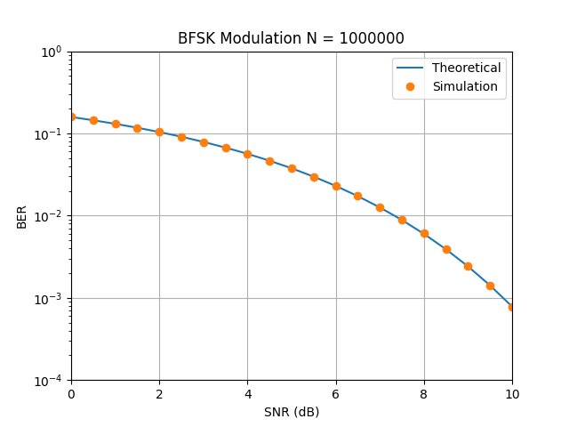
Compare two modulation schemes
Binary Phase Shift Keying, BPSK
Binary Frequency Shift Keying, BFSK

Slide 19
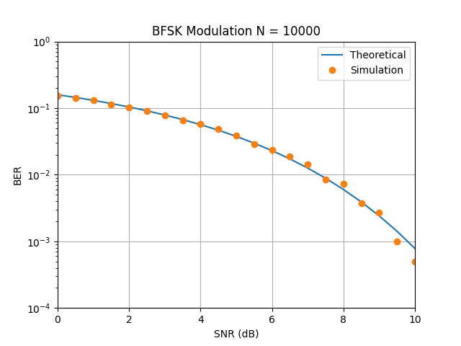
Compare two modulation schemes
Binary Phase Shift Keying, BPSK
Binary Frequency Shift Keying, BFSK

Slide 20
Monte Carlo simulation of SNR envelope
It is right to consider SNR constant over iterations?
Notes:
While average SNR provides a general idea of the signal strength, it doesn't capture the temporal evolution, or time-based changes, of the fading process. We need a way to account for these fluctuations.

Slide 21
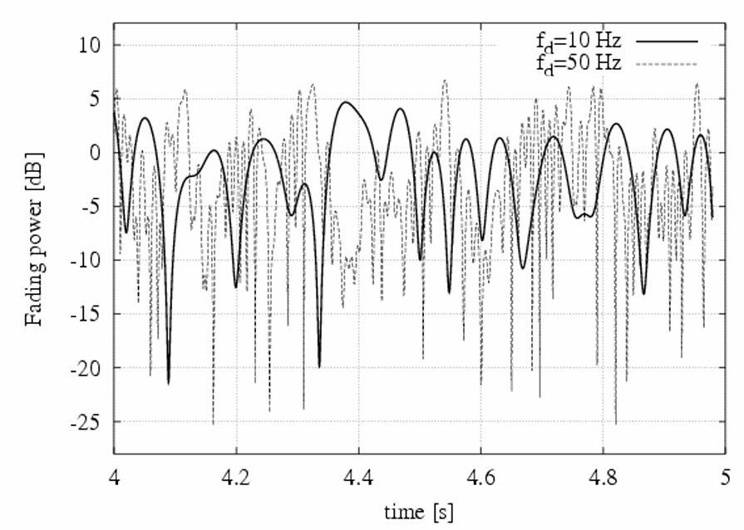
SNR envelope
As the wireless environment is not static, using just the average SNR is not enough to track the temporal evolution of the fading process: temporal dynamics (correlation).
The SNR envelope is affected by fluctuations over time.
These fluctuations can be described by an Finite State Markov Chain Monte Carlo model.
Notes:
The SNR envelope refers to the variation of SNR over time. The SNR envelope trace the changing signal strength over time, with peaks and dips reflecting the fading effects.
These fluctuations in the SNR envelope are critical for accurate performance analysis. Ignoring them could lead to underestimating the real-world scenarios. To address the limitations of average SNR and capture the dynamics of fading, we can leverage a powerful tool: the Markov Chain Monte Carlo (MCMC) model.
MCMC is a specialized Monte Carlo simulation technique that can model systems with memory. In our case, the fading process exhibits a certain level of memory – how strong the signal was at one point in time can influence its strength later. So, we incorporate MCMC in our simulation to generate more realistic and time-varying SNR envelopes, to evaluate performance under dynamic channel conditions.

Slide 22
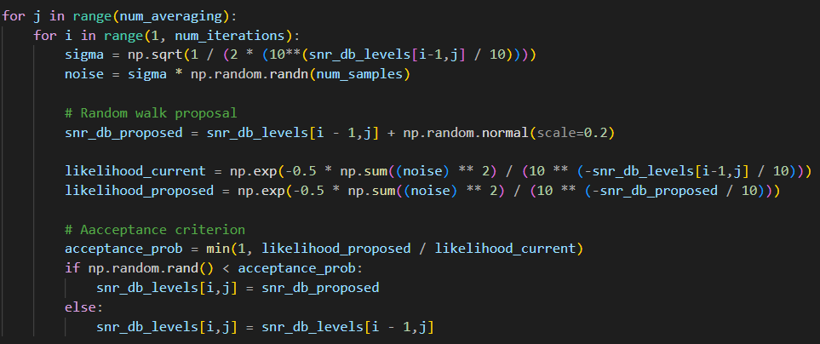

Python code
[…]
Notes:
Such definition presume that we have no a priori knowledge of the likelihood of a set of values for n
samples= 100000
iterations = 140
averaging = 20

Slide 23
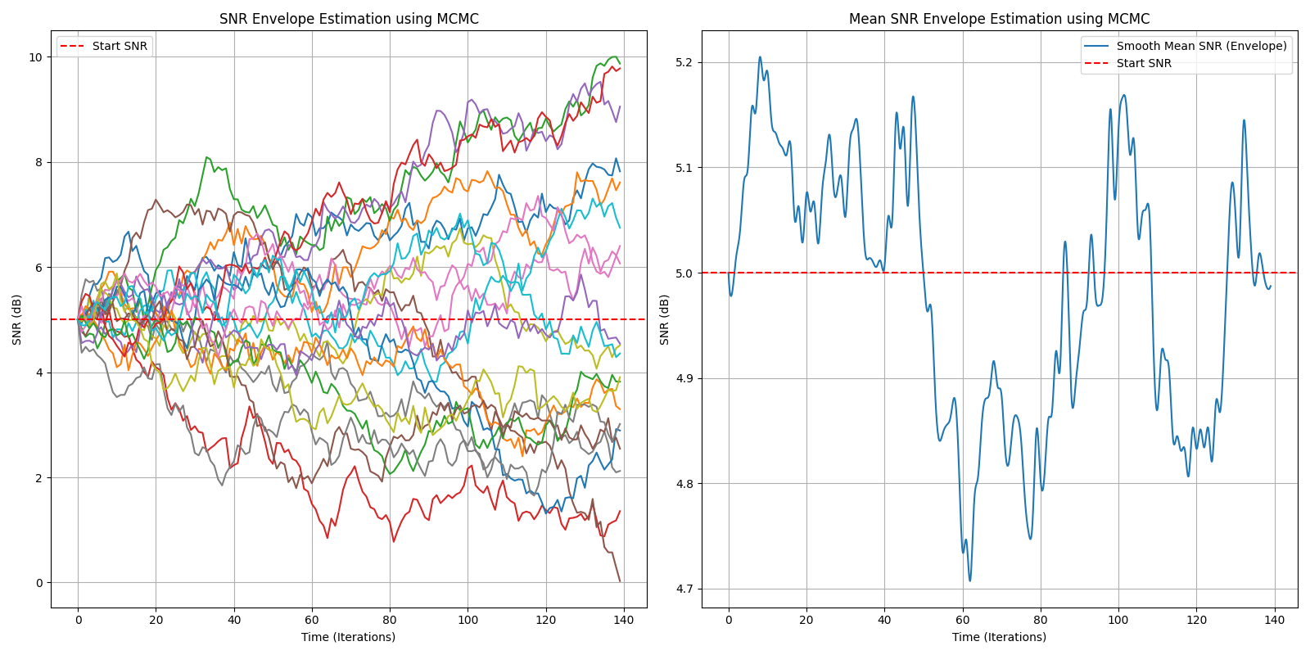
SNR envelope results

Slide 24
Conclusions
Is it worth using Monte Carlo simulation in wireless communication?

Slide 25
Using MC simulation in wireless communication systems
Monte Carlo technique leverage on the performance of stochastic, or random, experiments.
Traditional mathematical analysis may be ineffective in obtaining a description of a system;
Monte Carlo techniques provides a results that are represented as random variable; the properties of this random variable, such as the mean, convey valuable information about the quantity being simulated.
While Monte Carlo techniques can yield fast simulation results, they can also produce inaccurate outcomes if not executed with care.
However, by integrating mathematical analytical methods with Monte Carlo simulations, it's possible to achieve fast and accurate results.
Notes:
In conclusion, Monte Carlo technique is a powerful tool for analysing communication systems. This method leverages the power of stochastic simulations, or random experiments.
Traditional mathematical analysis struggle to accurately describe complex systems like wireless communication. This is where Monte Carlo simulations come in. They allow us to evaluate system performance by repeatedly simulating its behaviour under controlled conditions. These conditions can include variations in factors like noise levels and channel impairments.
The results obtained from Monte Carlo simulations are typically represented as random variables. These variables possess properties like a mean (average) value. By analysing these properties, we gain valuable insights into the system's performance, such as the average Bit Error Rate (BER) under different scenarios.
It's important to acknowledge that while Monte Carlo simulations can provide fast results, they can also generate inaccurate outcomes if not executed carefully. Choosing appropriate simulation parameters and ensuring proper randomness are crucial for obtaining reliable results.
However, one of the key strengths of Monte Carlo simulations is their ability to be combined with traditional mathematical methods. By integrating these approaches, we can achieve a powerful combination: fast simulation speeds from Monte Carlo techniques and high accuracy from mathematical analysis.
This synergy allows us to gain a comprehensive understanding of communication system performance and optimize its design for real-world applications.

Slide 26
References
Poniran, Mazlina. "Monte Carlo simulation in communication system." (2009)
Rossi, Michele. “Link Layer Errors Models”, lecture notes of Wireless Networks, University of Padua. 2023
William H.Tranter, K.Sam Shanmugam, "Communication system simulation with wireless Application," Prentice Hall

Slide 27
Thank you! Gracias! Grazie!
Giacomo Calabria
Notes:
Thank you for your attention!

